Slide 1

Inside the World's Largest Python Course on Coursera (and edX)
Dr. Charles Severance
University of Michigan School of Information

Slide 2
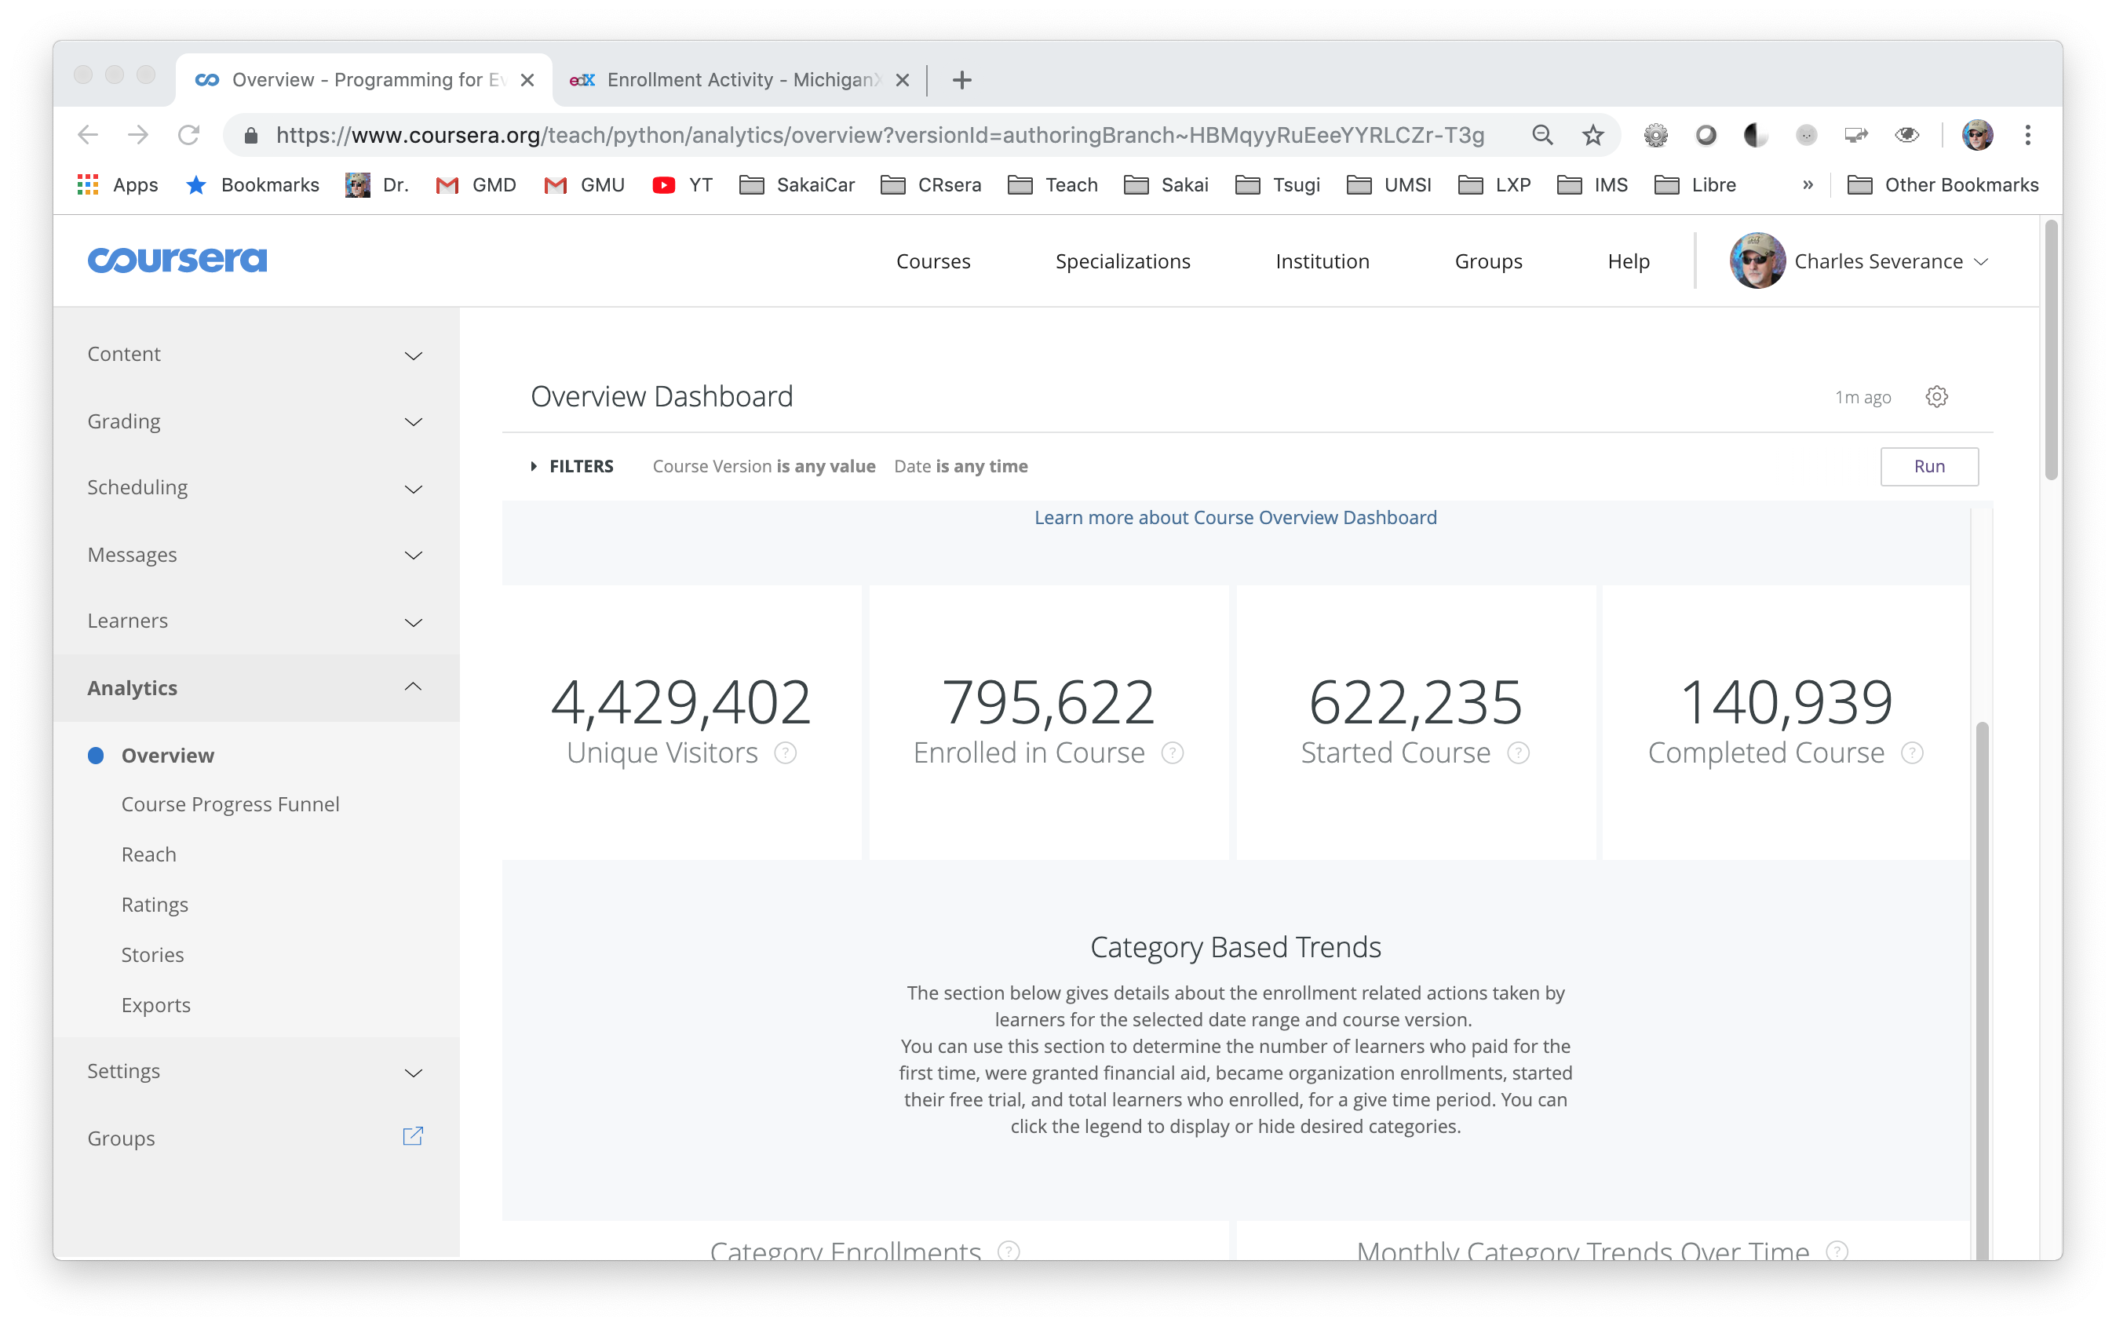

Slide 3
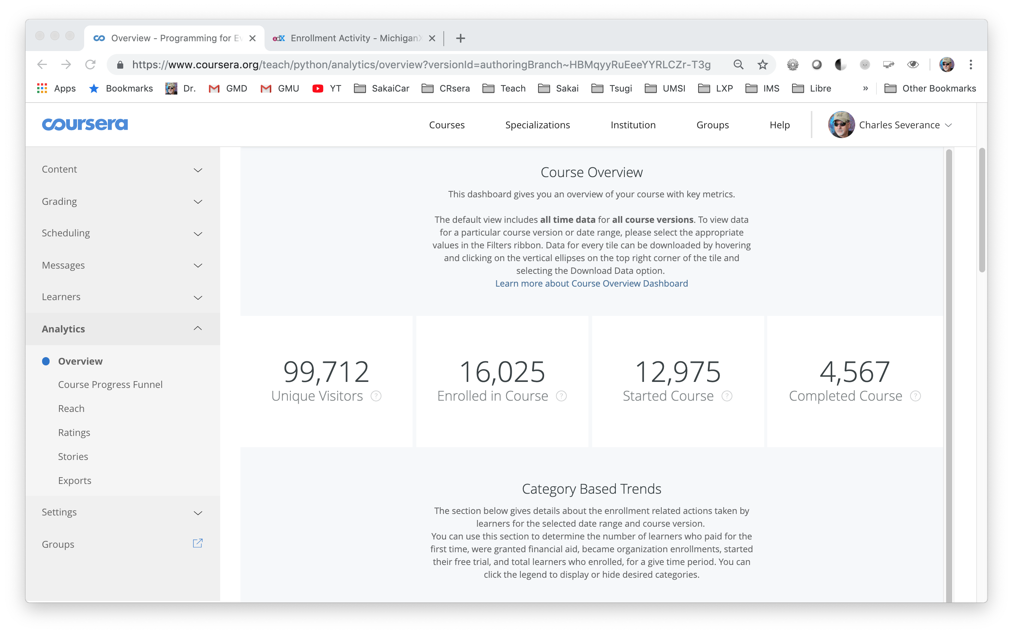
Last Month

Slide 4
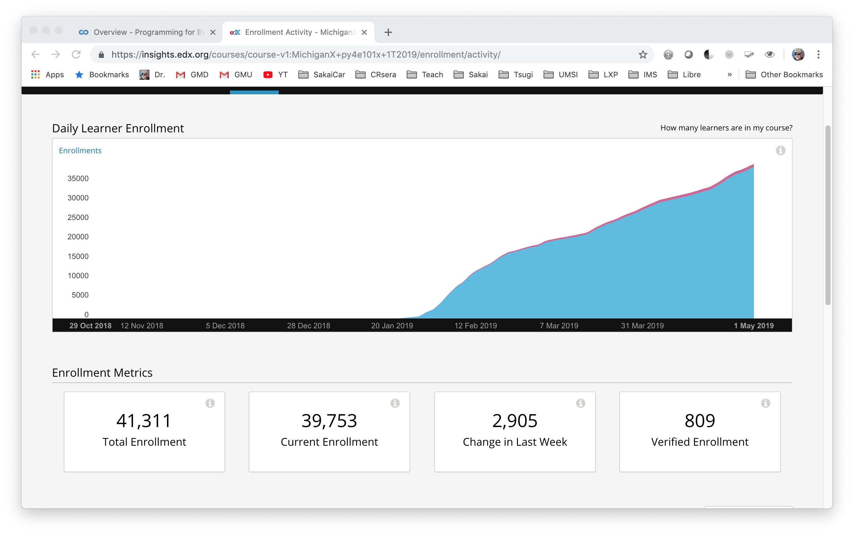
Last Three Months

Slide 5
Before I Met Python
Three Computer Science Degrees
Taught Programming since 1981 (APL, FORTRAN, PASCAL ….)
Building Online Educational Technology since 1997
Teaching with streaming media online since 1997
Open Source Educational Technology – Sakai Project since 2002
Educational Technology Standards Leadership since 2004

Slide 6
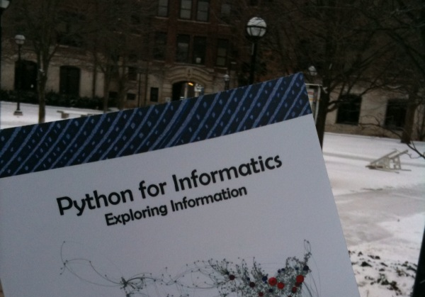
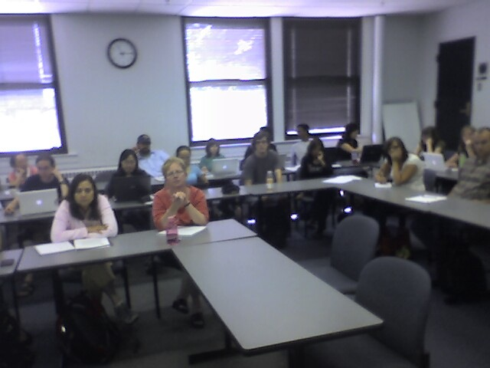
"Hello Python" - 2008

Slide 7

An Introduction to Programming and Technology Not an Introduction to Computer Science

Slide 8
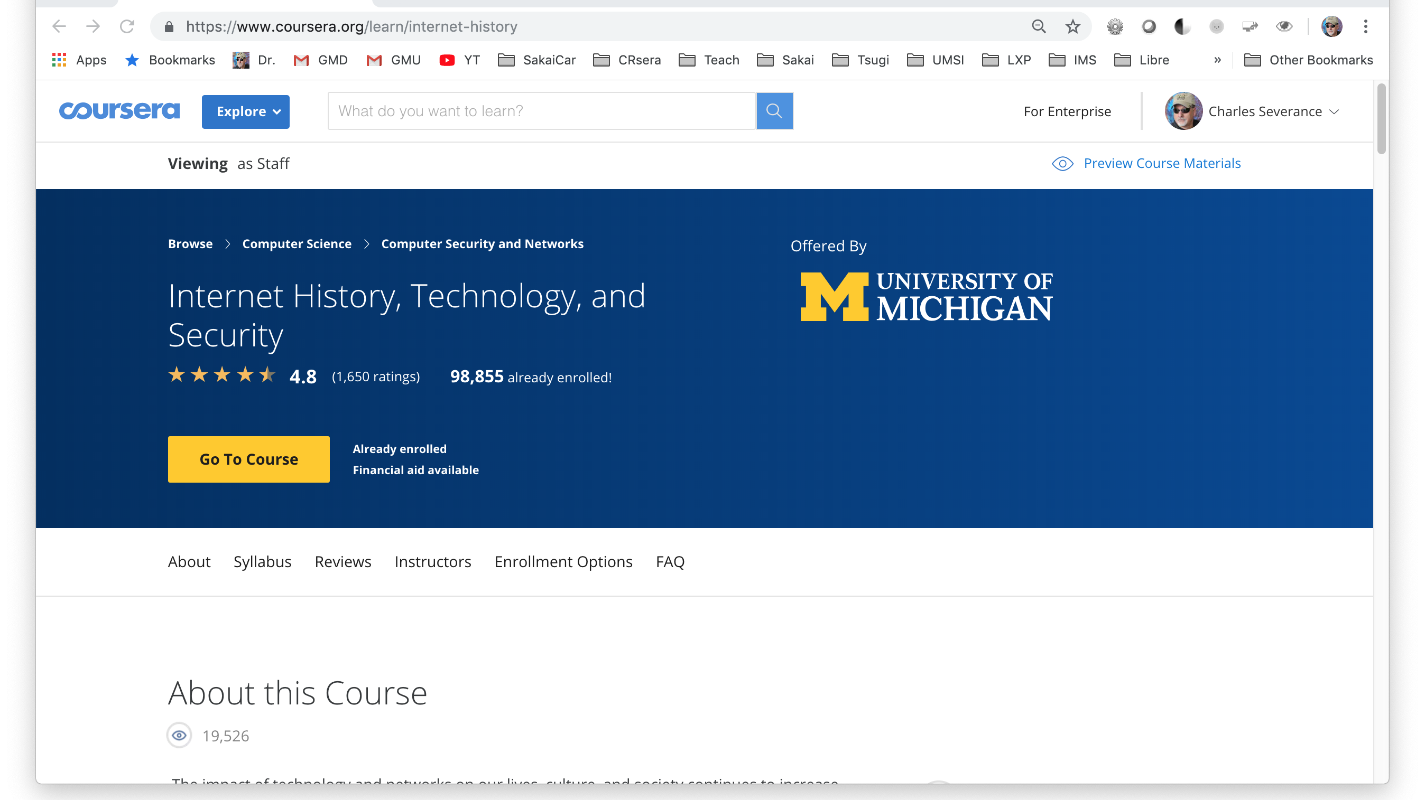
MOOCS "Happen" - 2012

Slide 9
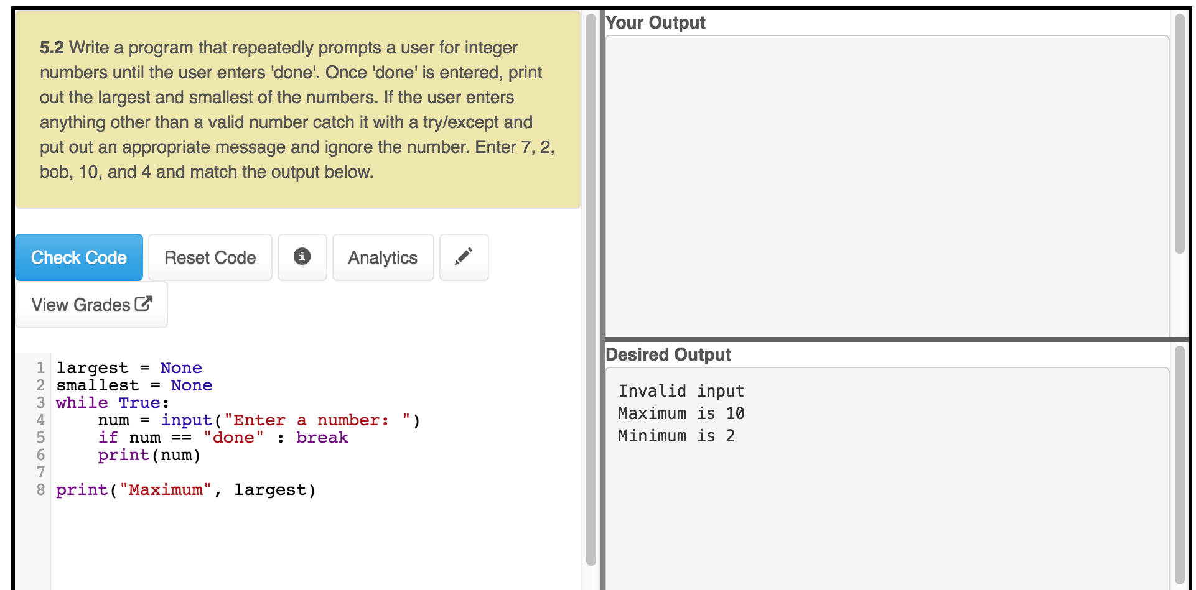
Learning Tools Interopability (LTI) Based Python Autograders
First 10 weeks – 100% in-browser option

Slide 10
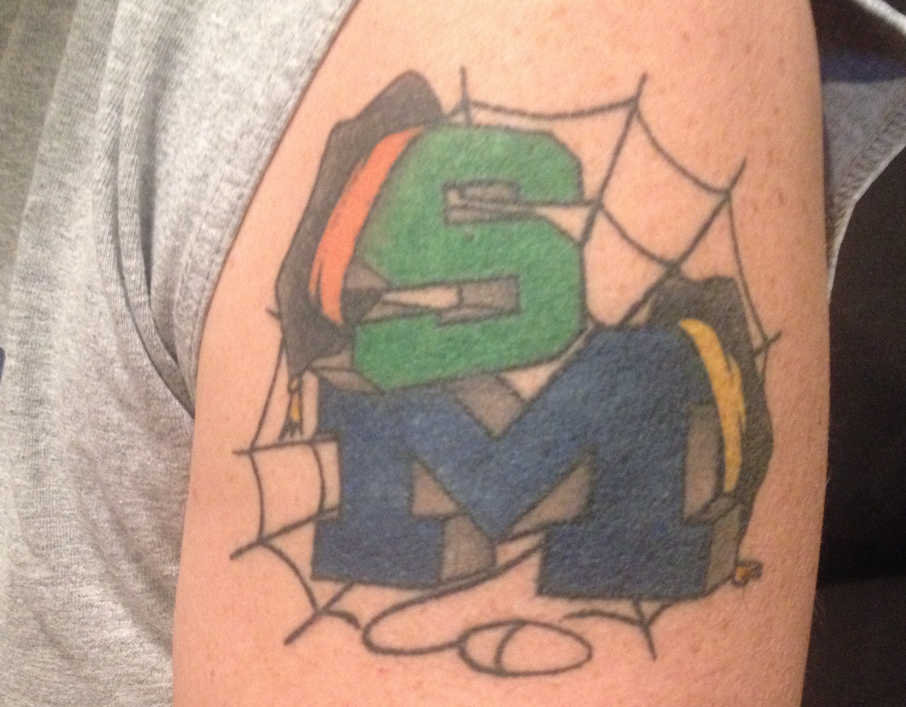
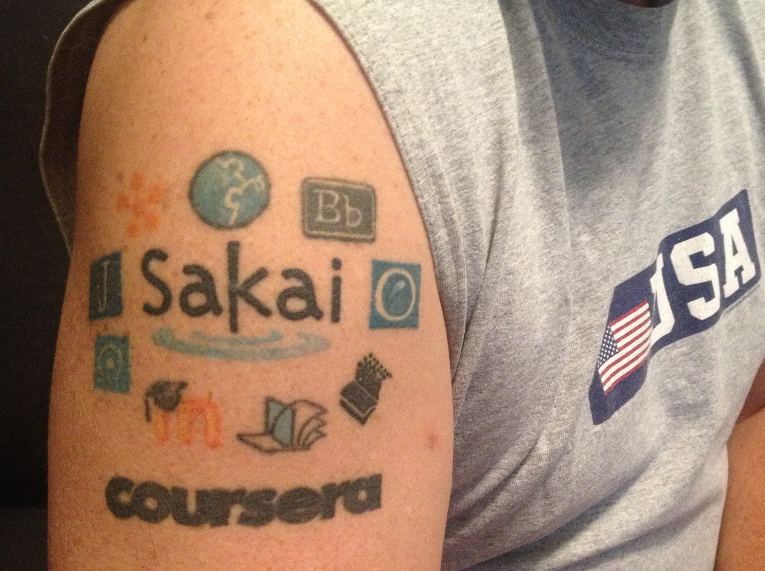
Tattoos Happen - 2013

Slide 11
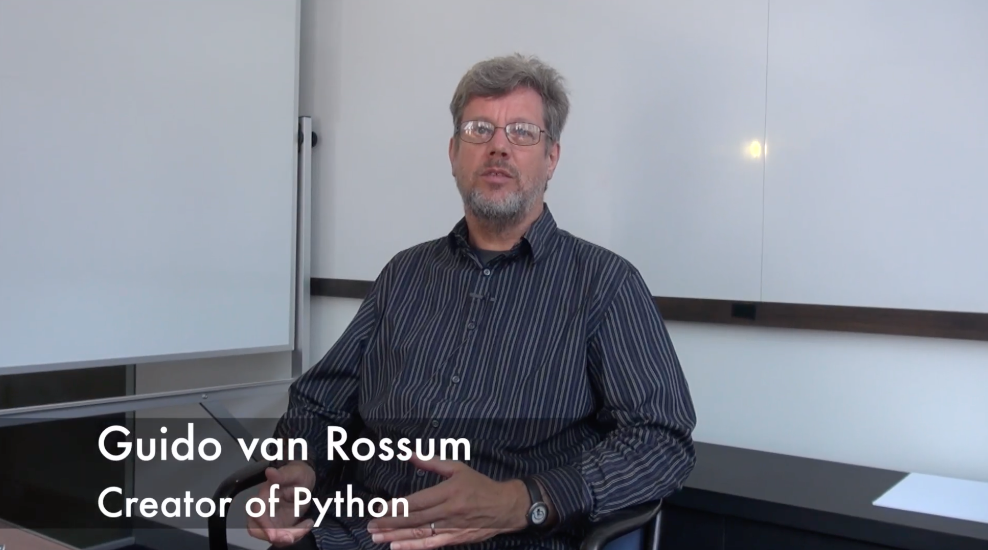
Hi I am Guido van Rossum…

Slide 12
New York, Los Angeles, Ann Arbor, Chicago, Washington DC, Memphis, Seattle, Seoul, Barcelona, London, Mexico City, Amsterdam, Manila Melbourne, Perth...
http://www.dr-chuck.com/office
Notes:
Since I have a very active travel schedule, I decided to hold office hours in the major cities I have visited. I have held office hours in over 40cities and in each location somewhere between two and 15 students show up.

Slide 13
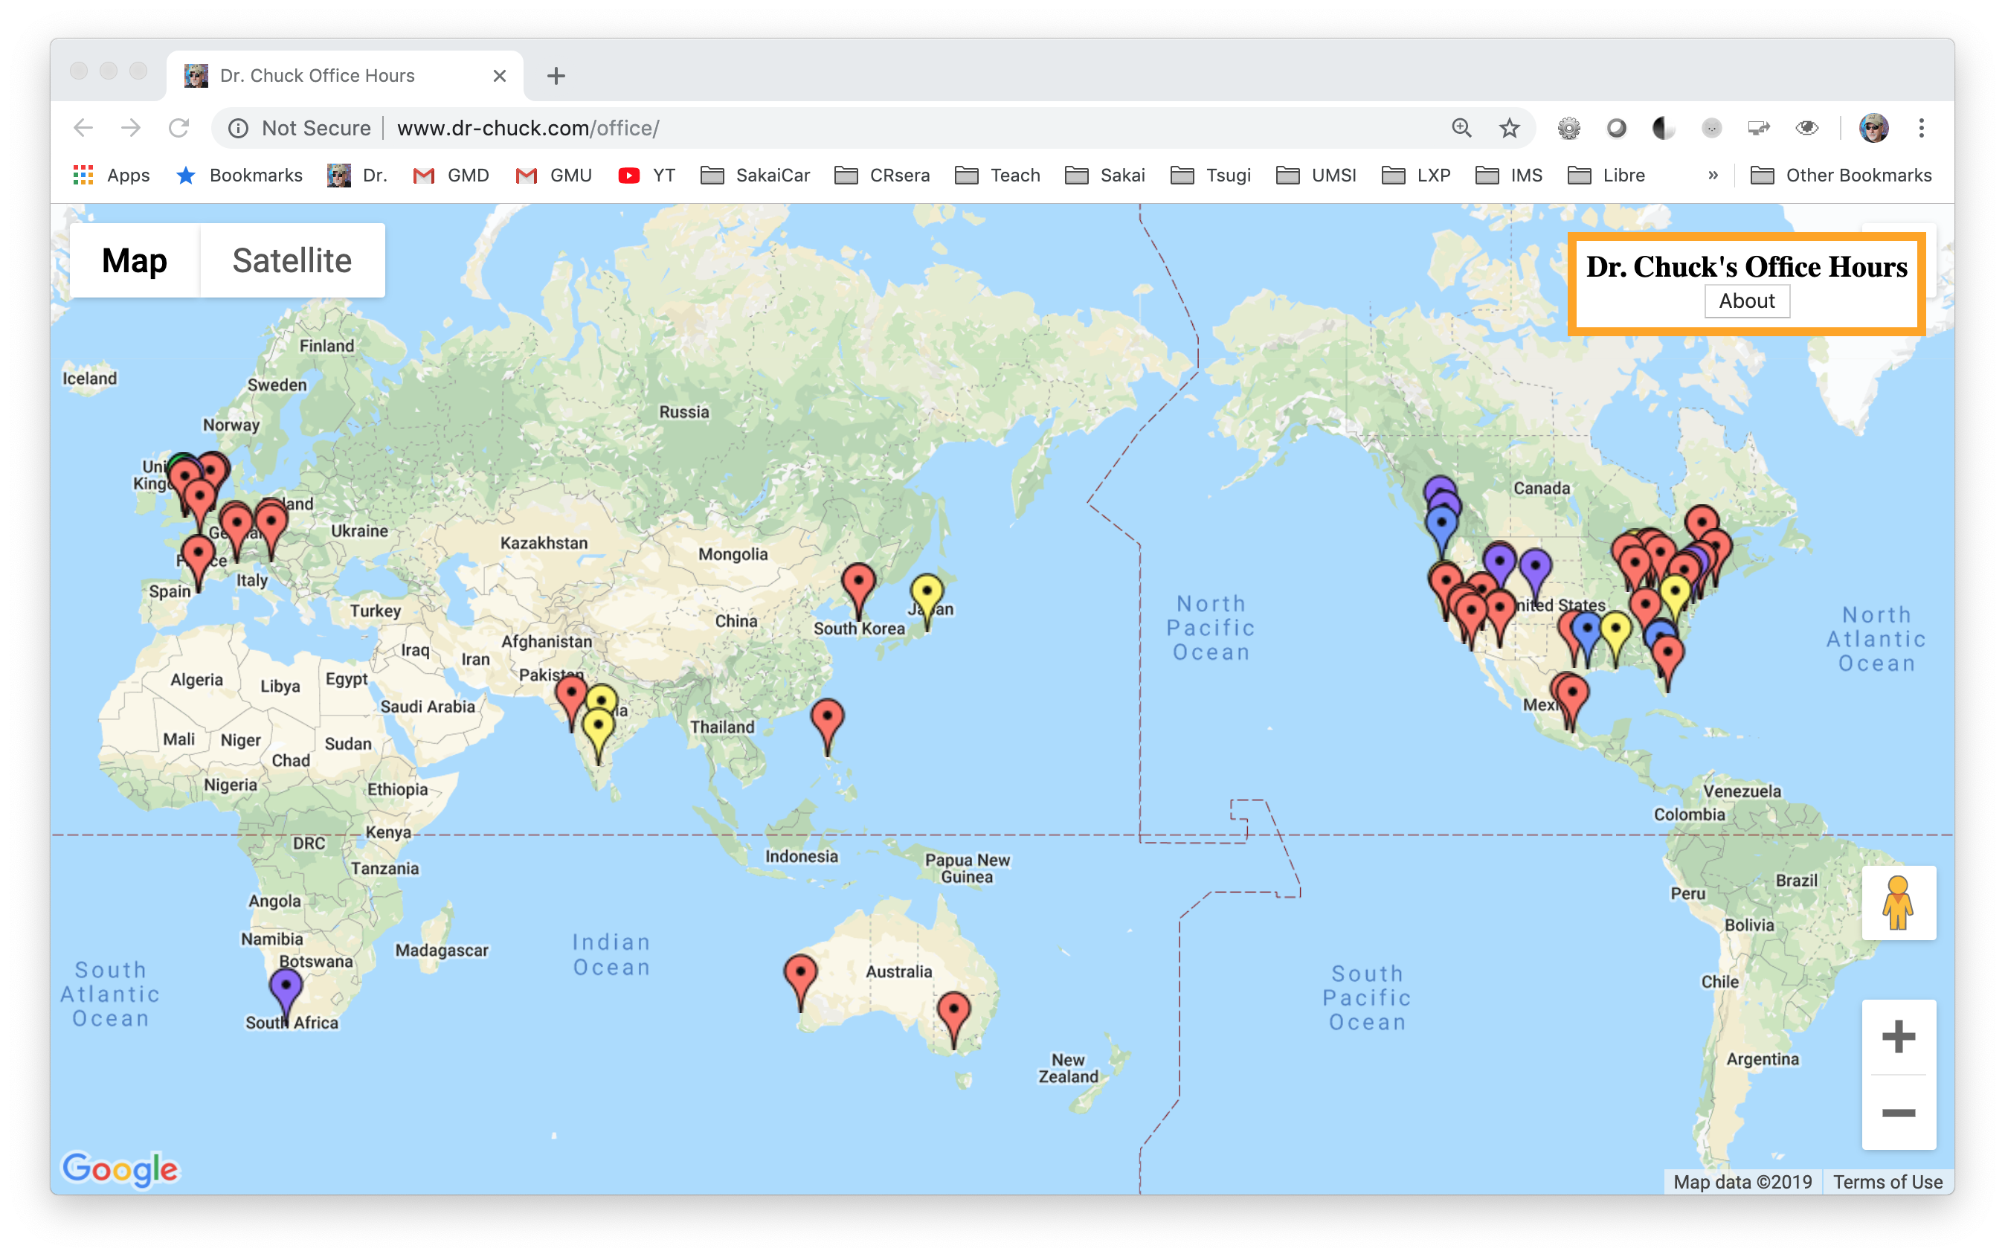
Students Around The World

Slide 14
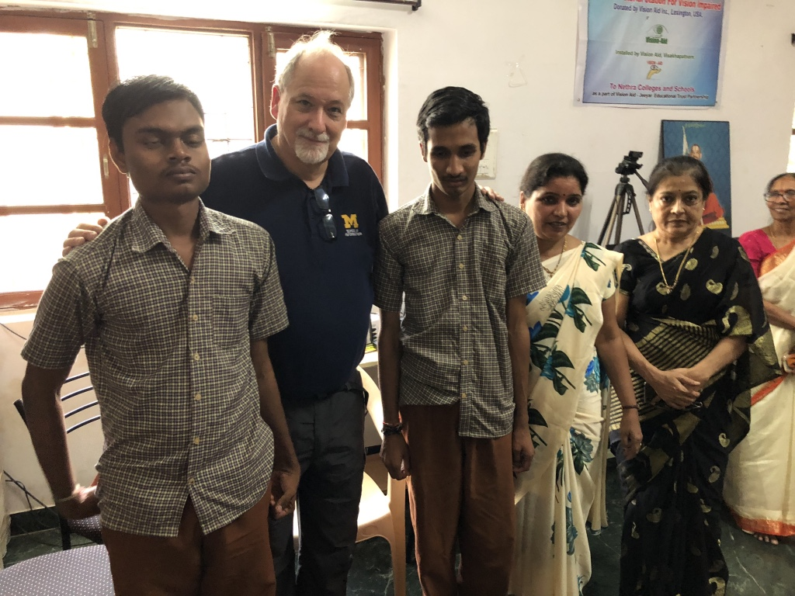
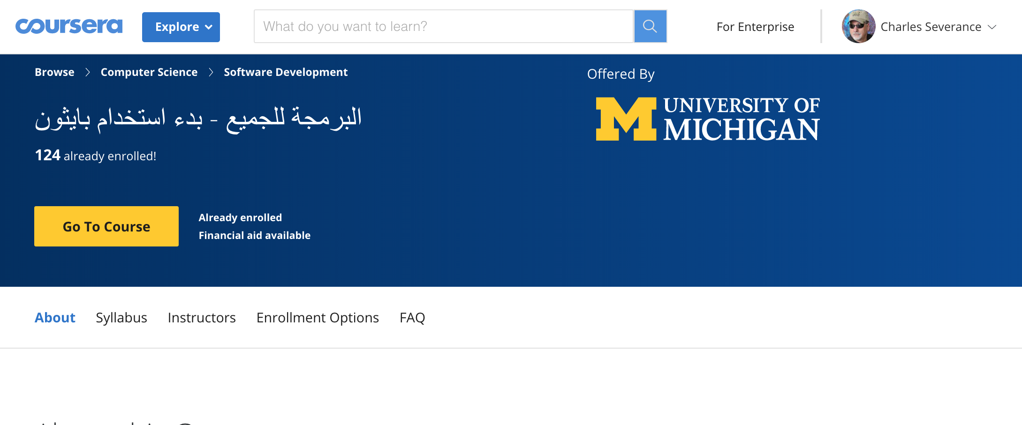
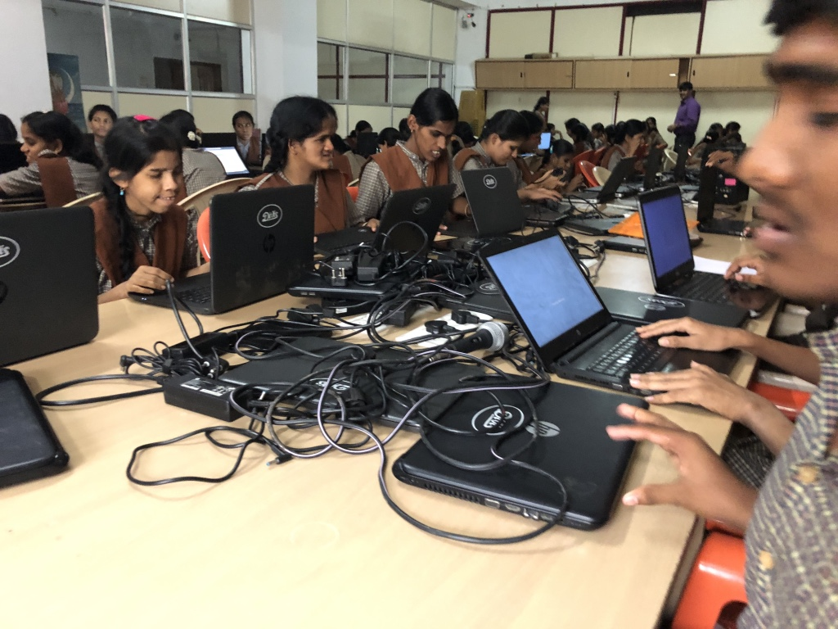
Python for Everybody - Everywhere

Slide 15
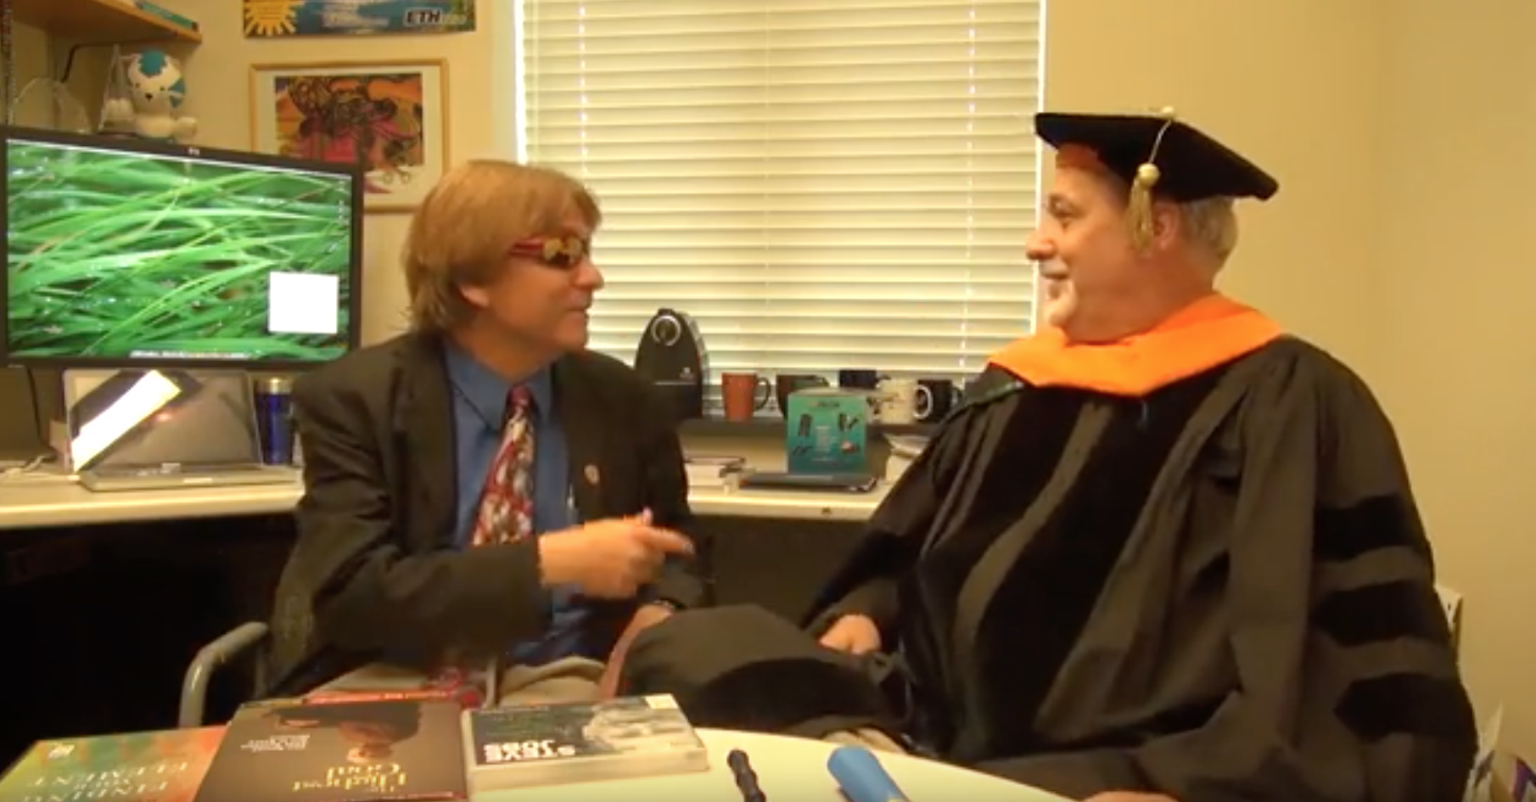
https://www.youtube.com/watch?v=SfQYA0JQWkA

Slide 16
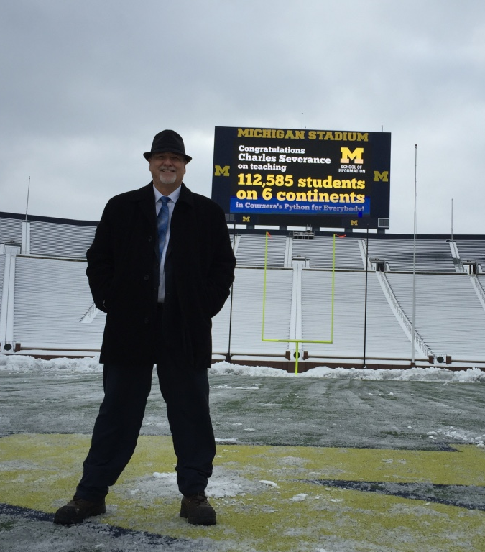
A Stadium Full of Students 2016

Slide 17
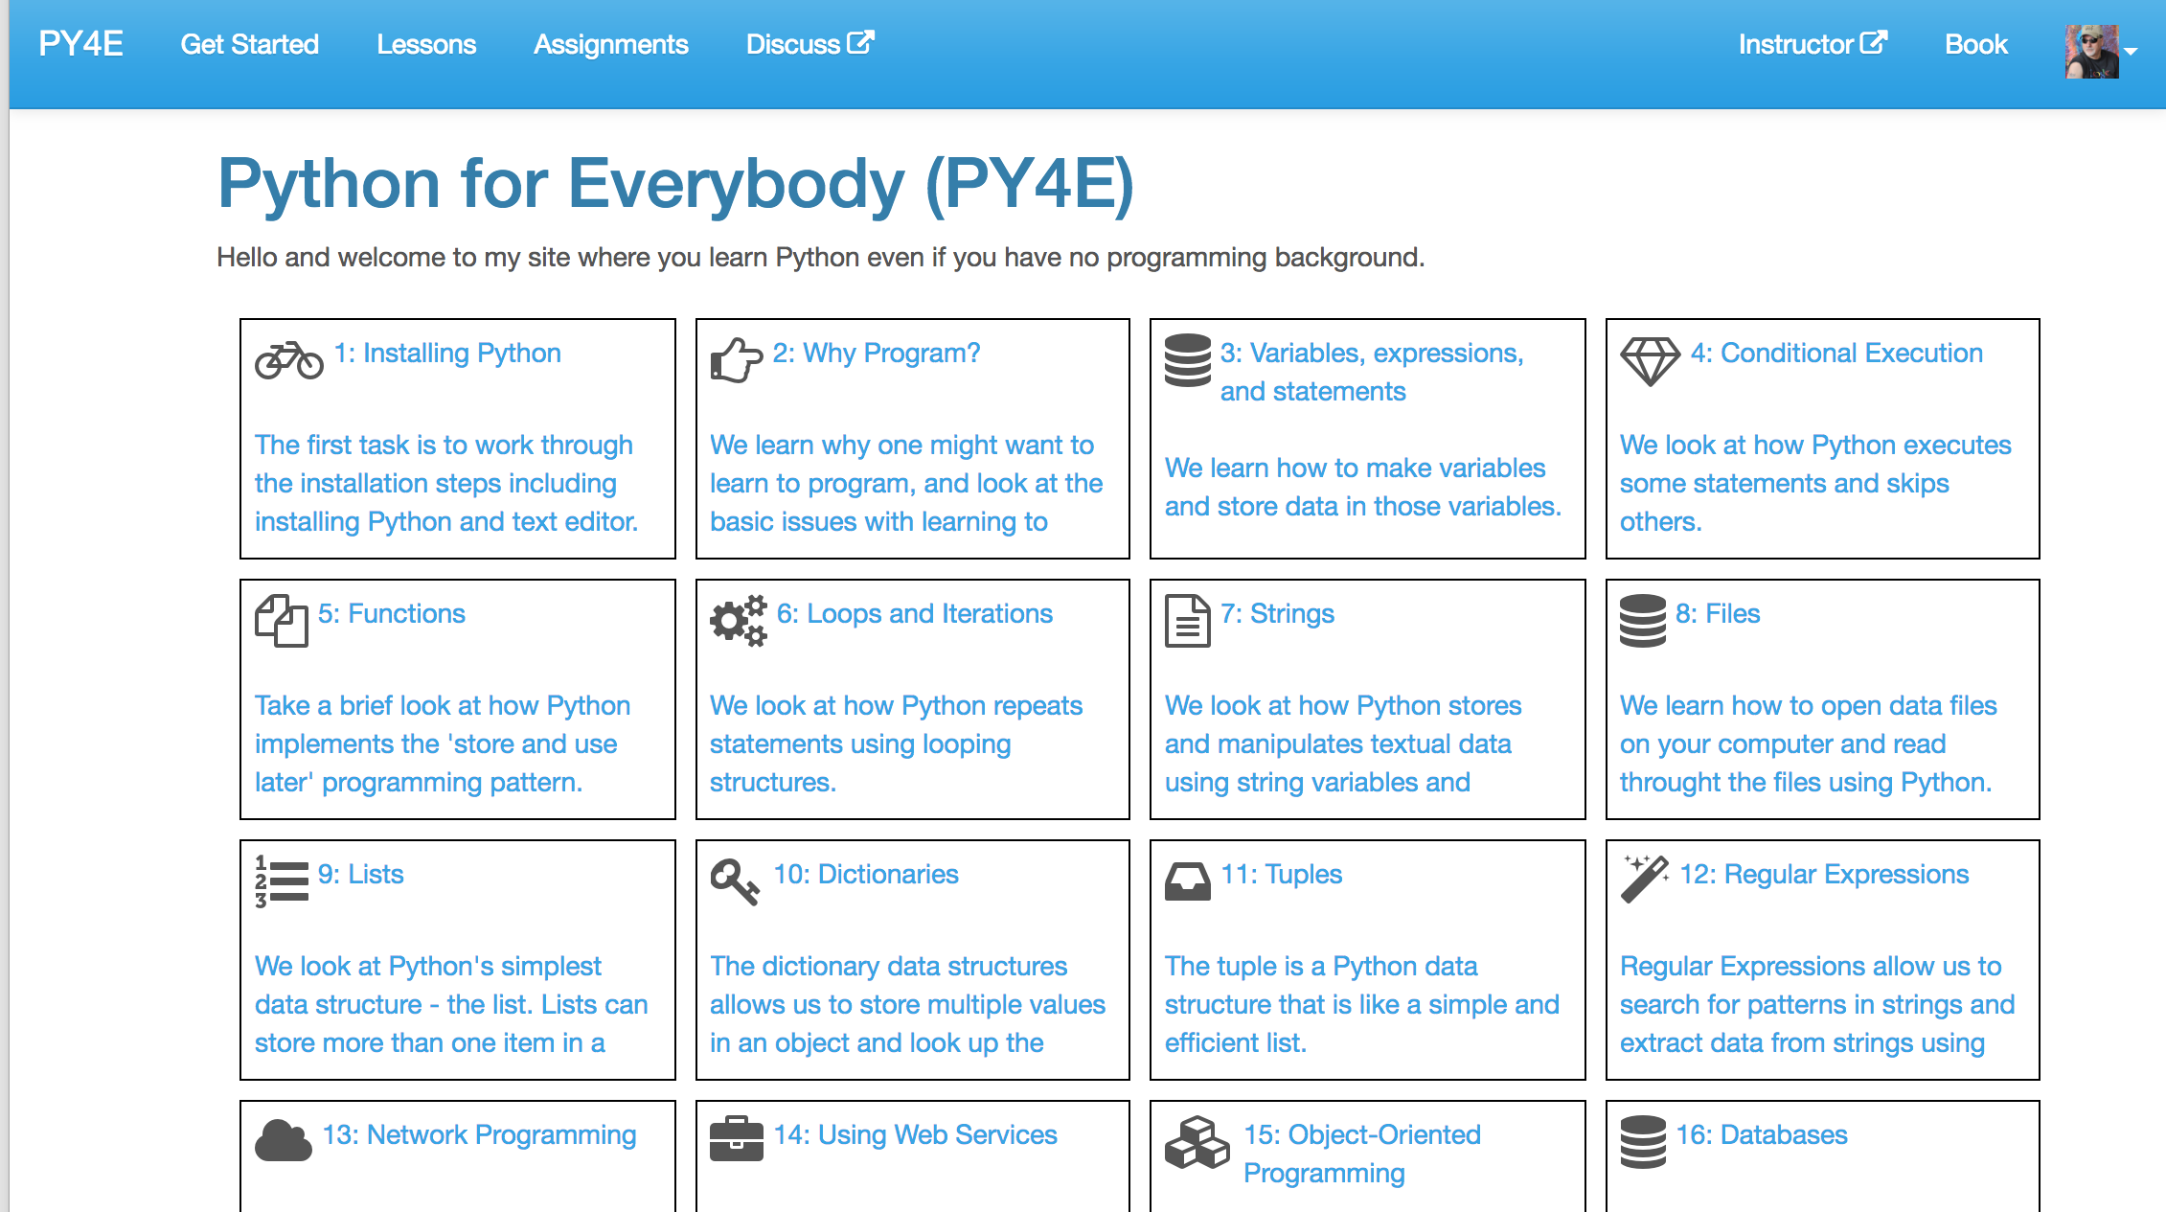
www.py4e.com

Slide 18
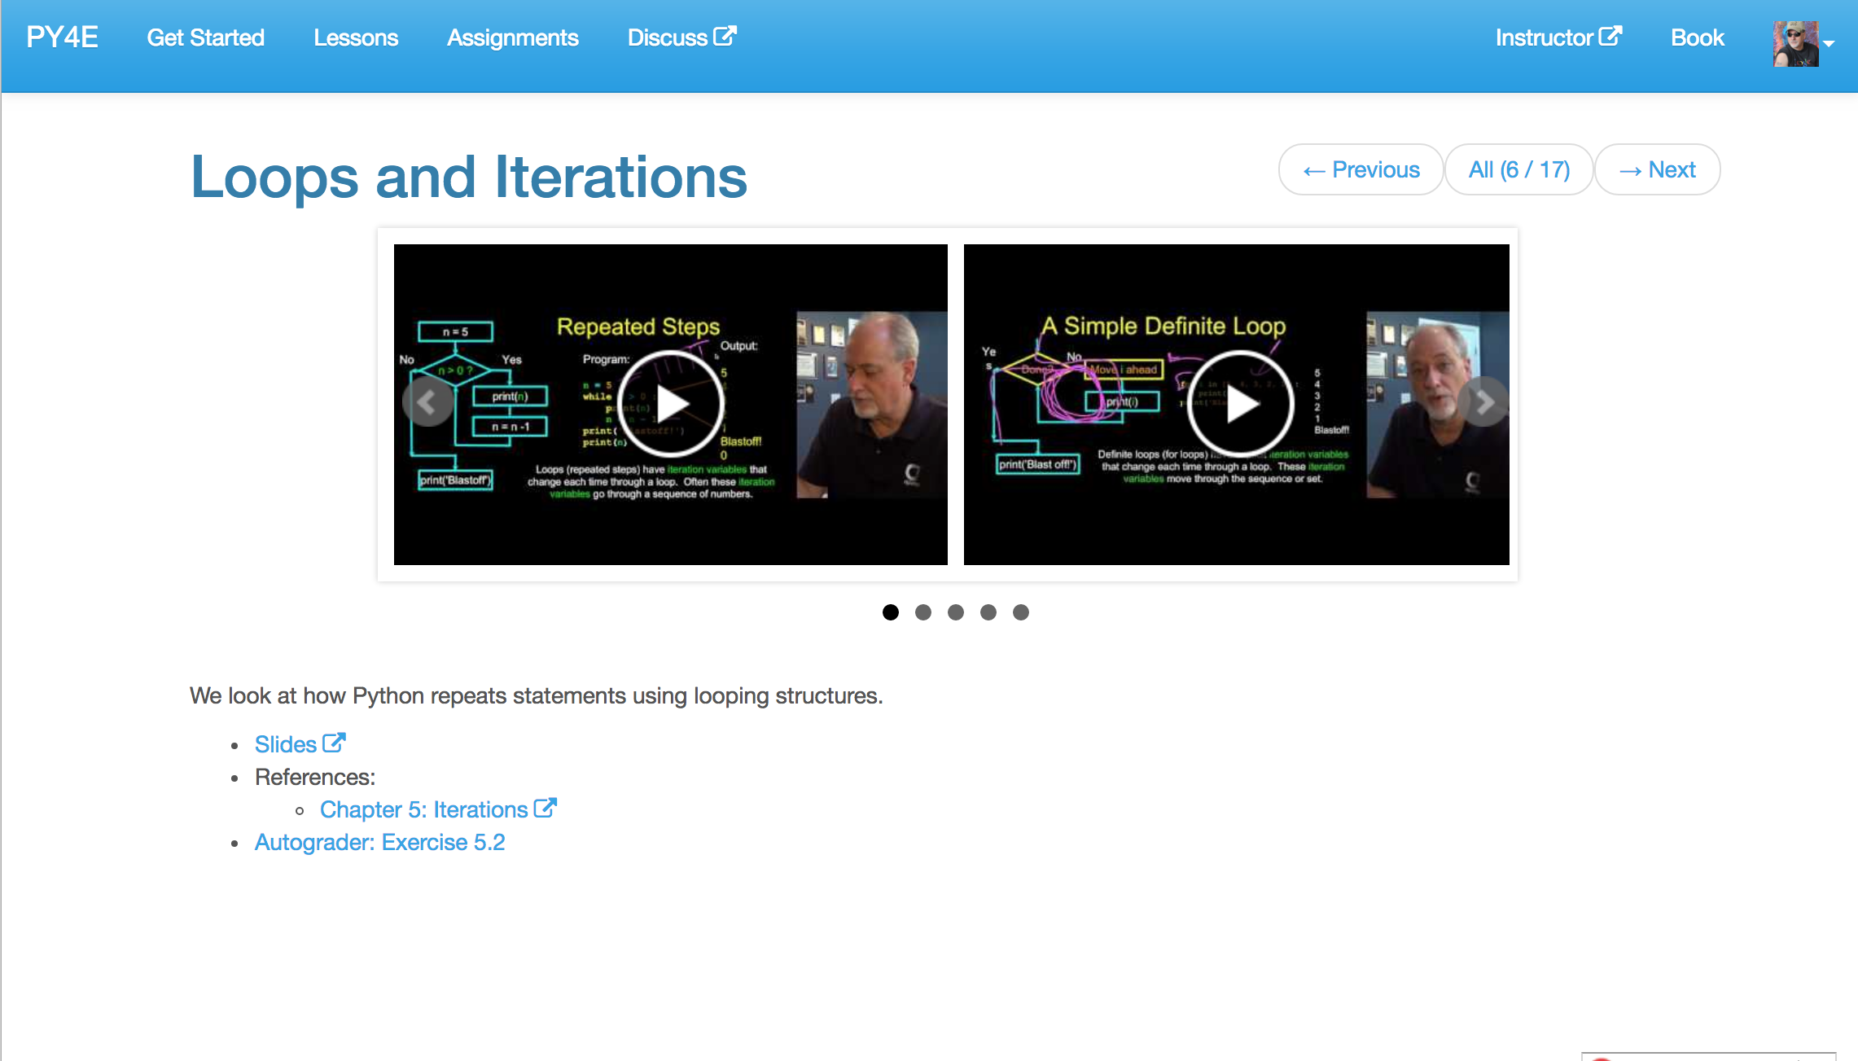
www.py4e.com
#OER

Slide 19
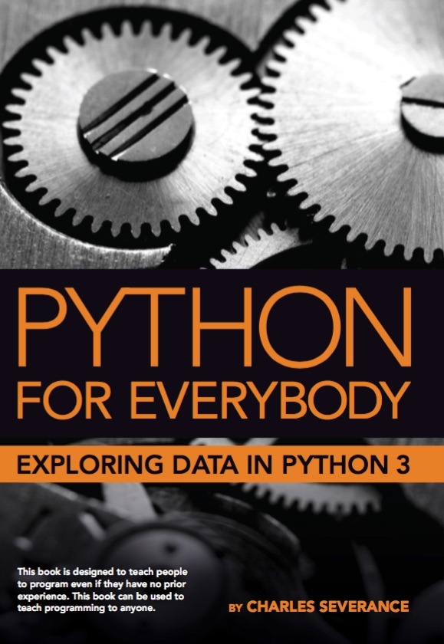
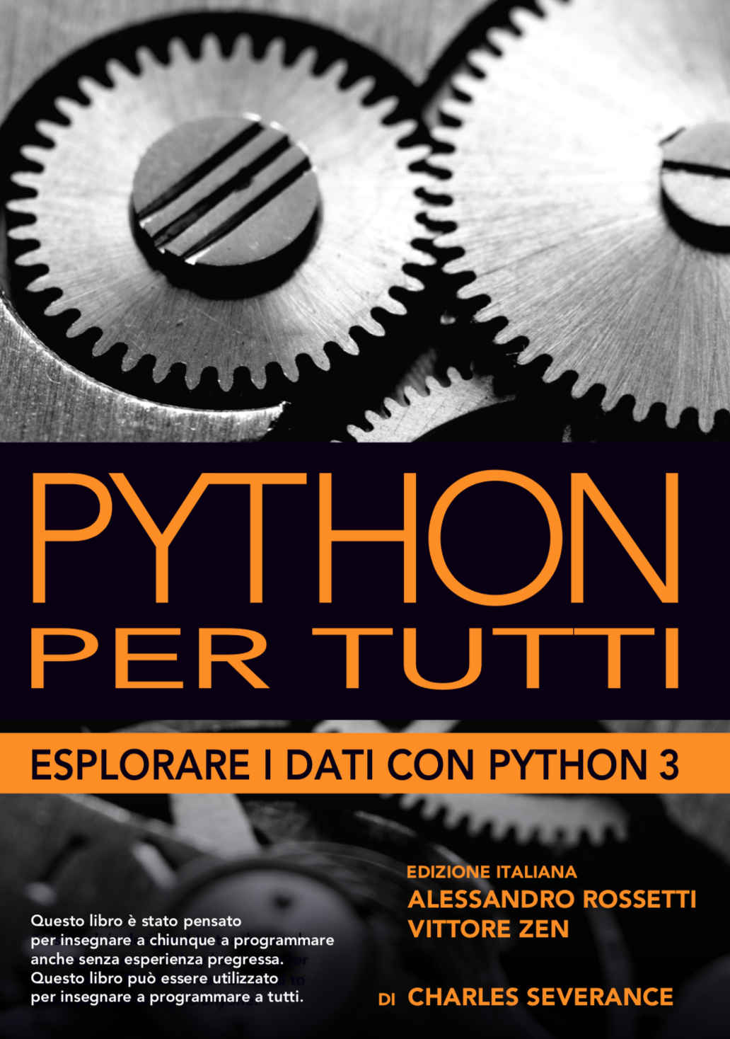
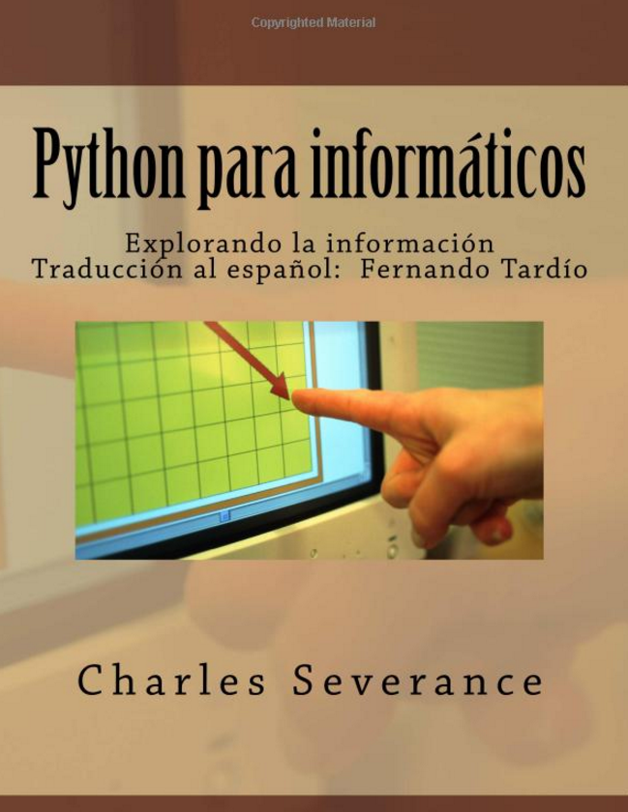
Adapted from: How to Think Like a Computer Scientist, by Alan Downey, Jeff Elkner
Chinese, Portuguese, and Korean
2008 - present

Slide 20
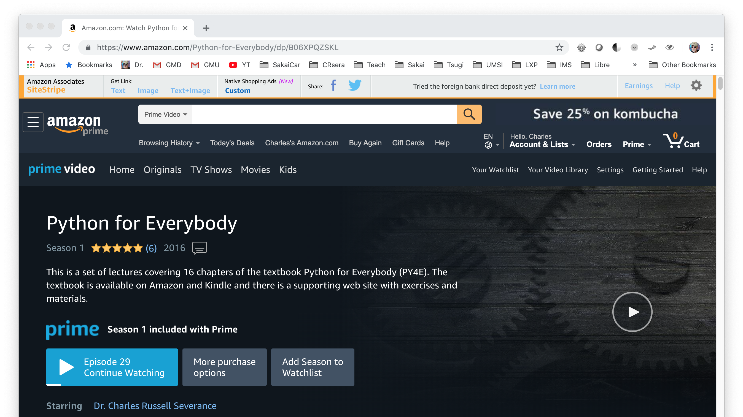

Slide 21
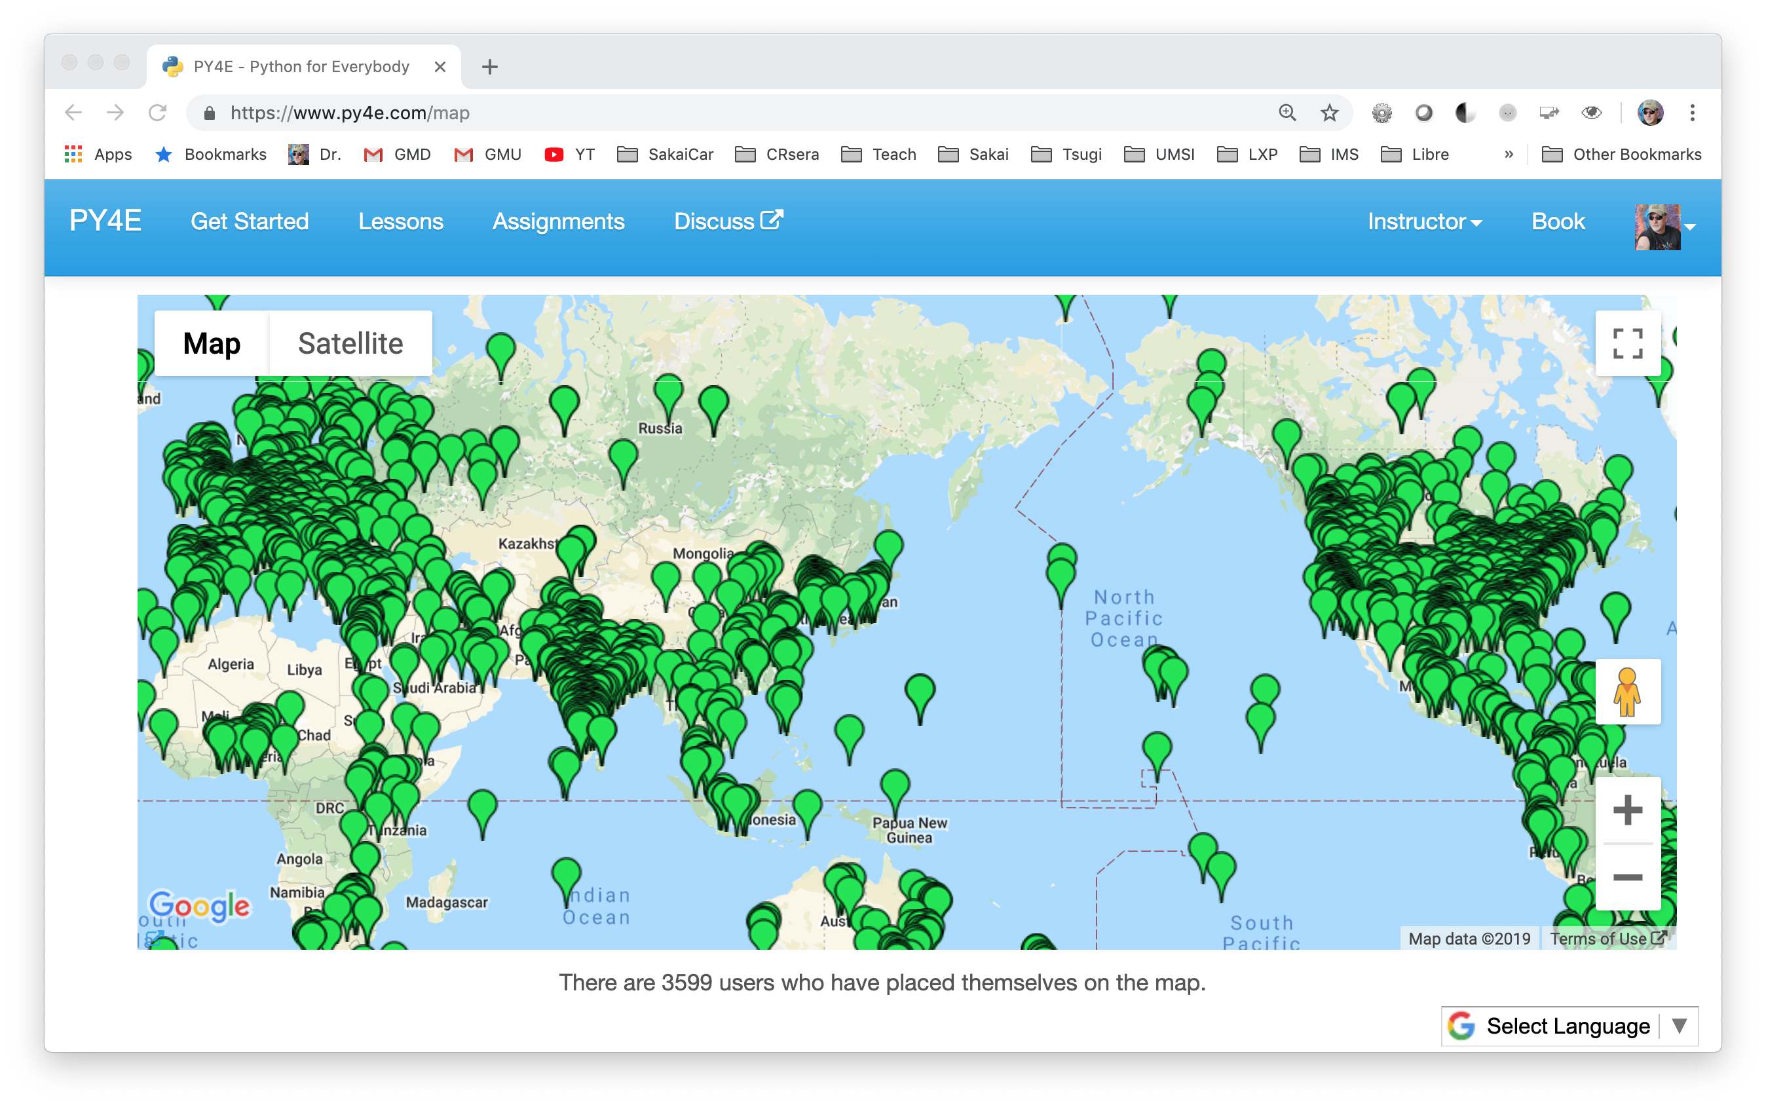

Slide 22
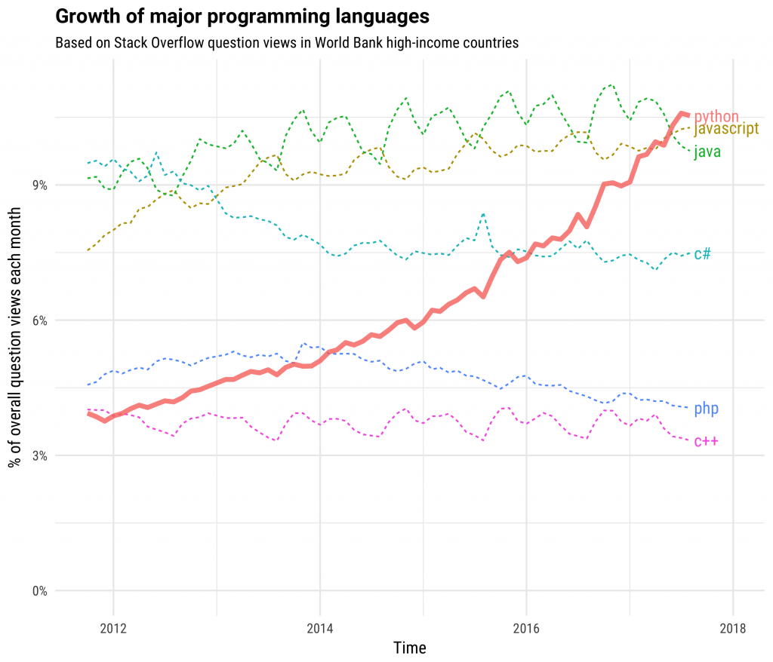

https://stackoverflow.blog/2017/09/06/incredible-growth-python/

Slide 23
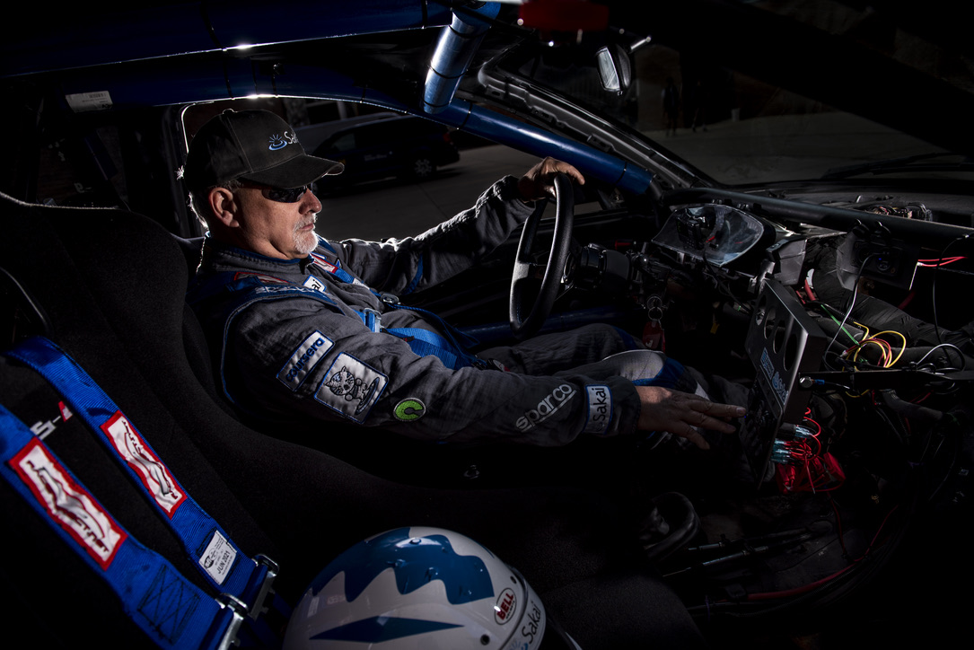
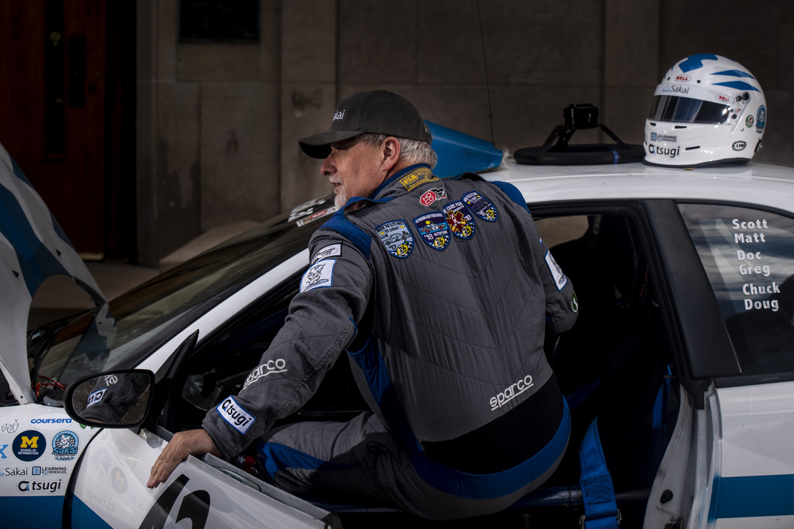
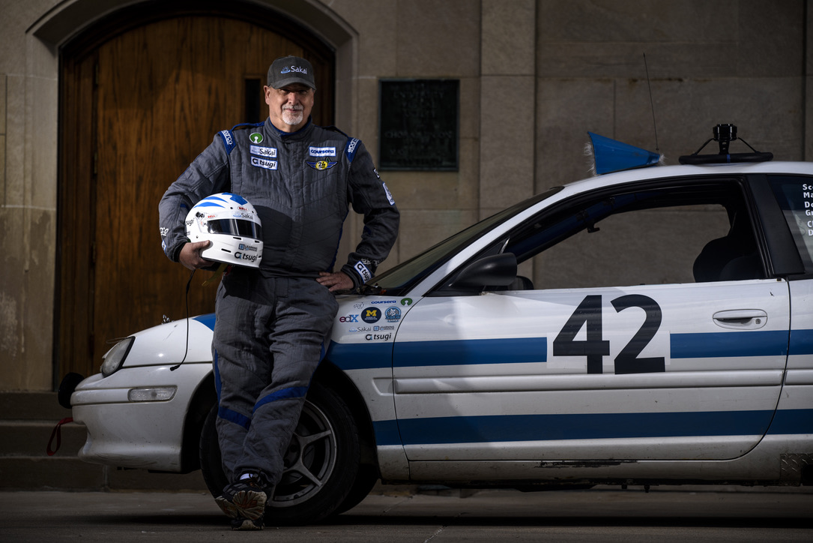
www.sakaiger.com/sakaicar

Slide 24

Now Where?

Slide 25
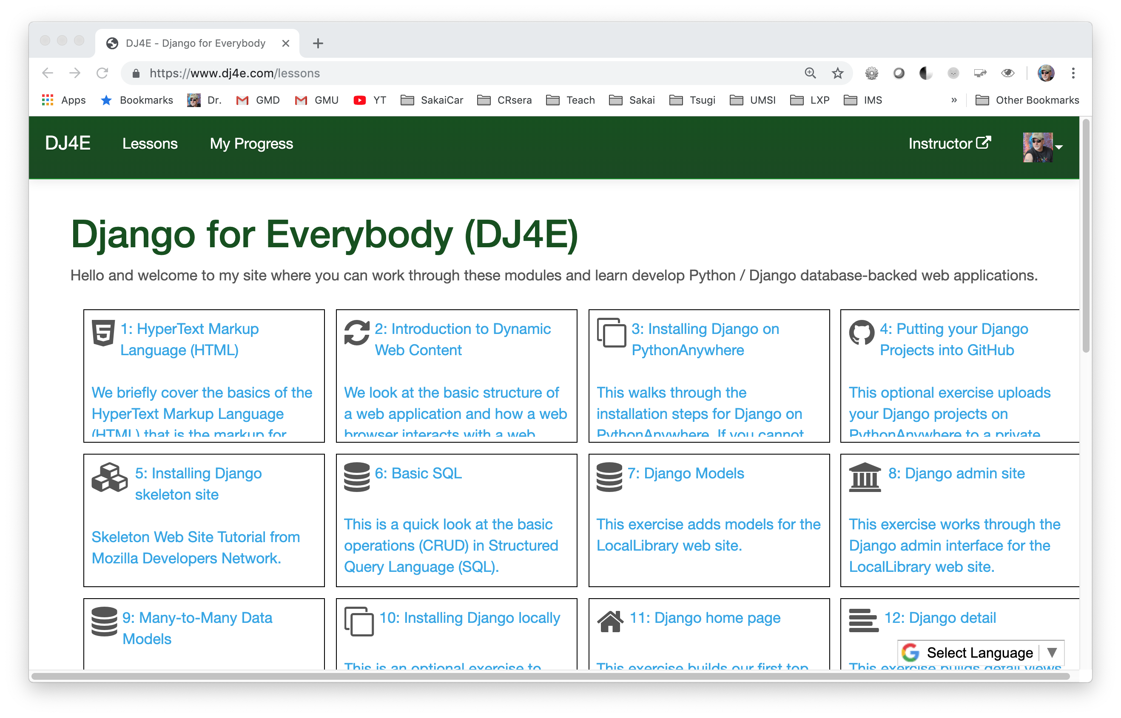

Slide 26
Liberal Arts Technology (LAT)
The goal for this effort is to develop a technology curriculum that can be easily added to the course catalog of a liberal arts school/college. Through a combination of course design, supporting material, a teacher community and teacher training - these course will be taught naturally be liberal arts faculty. These courses will not require the hiring of Computer Science Faculty or adjunct specialists. The learning will always be grounded in Liberal Arts Principles. This program is not intended as a replacement for a Computer Science curriculum, but can be used to better prepare students for more advanced computer science courses if the students are interested in those courses.
Throughout this program, the focus is on using free and openly licensed course materials to keep the cost of this program as low as possible for adopting institutions. The free and licensed materials will include books, quizzes, PowerPoint slides, automated grading software, and other supporting material to help teachers come up to speed quickly.

Slide 27
Programming Curriculum
CS1
APCS
Java
3 Cr (12)
HW4E (ch 1-10)
Circuits/Gates
1.5 Cr (11)
CC4E (ch 1-10)
C / Alg / Data St
3 Cr (11)
WD4E (Part 2)
Design / Accessibility
1.5 Cr (9/10)
DJ4E
Django/JS
3.0 Cr (10/11)
PY4E (Part 2)
Data Analysis
3 Cr (10/11)
WD4E (Part 1)
HTML/CSS
1.5 Cr (8/9)
PY4E (Part 1)
Programming
1.5 Cr (8/9)
Scratch/MindStorms/etc… 6/7/8

Slide 28
TsugiCloud – Building Educational Apps
from django.shortcuts import render
from django.views import View
from django_tsugi.mixins import TsugiMixin
class GradeView(TsugiMixin, View):
def get(self, request) :
context = {'tsugi': request.tsugi}
return render(request, 'grade/main.html', context)
def post(self, request) :
grade = float(request.POST.get('grade'))
comment = request.POST.get('comment')
retval = request.tsugi.result.gradeSend(grade, comment)
context = {'tsugi': request.tsugi, 'retval' : retval}
return render(request, 'grade/done.html', context)

Slide 29
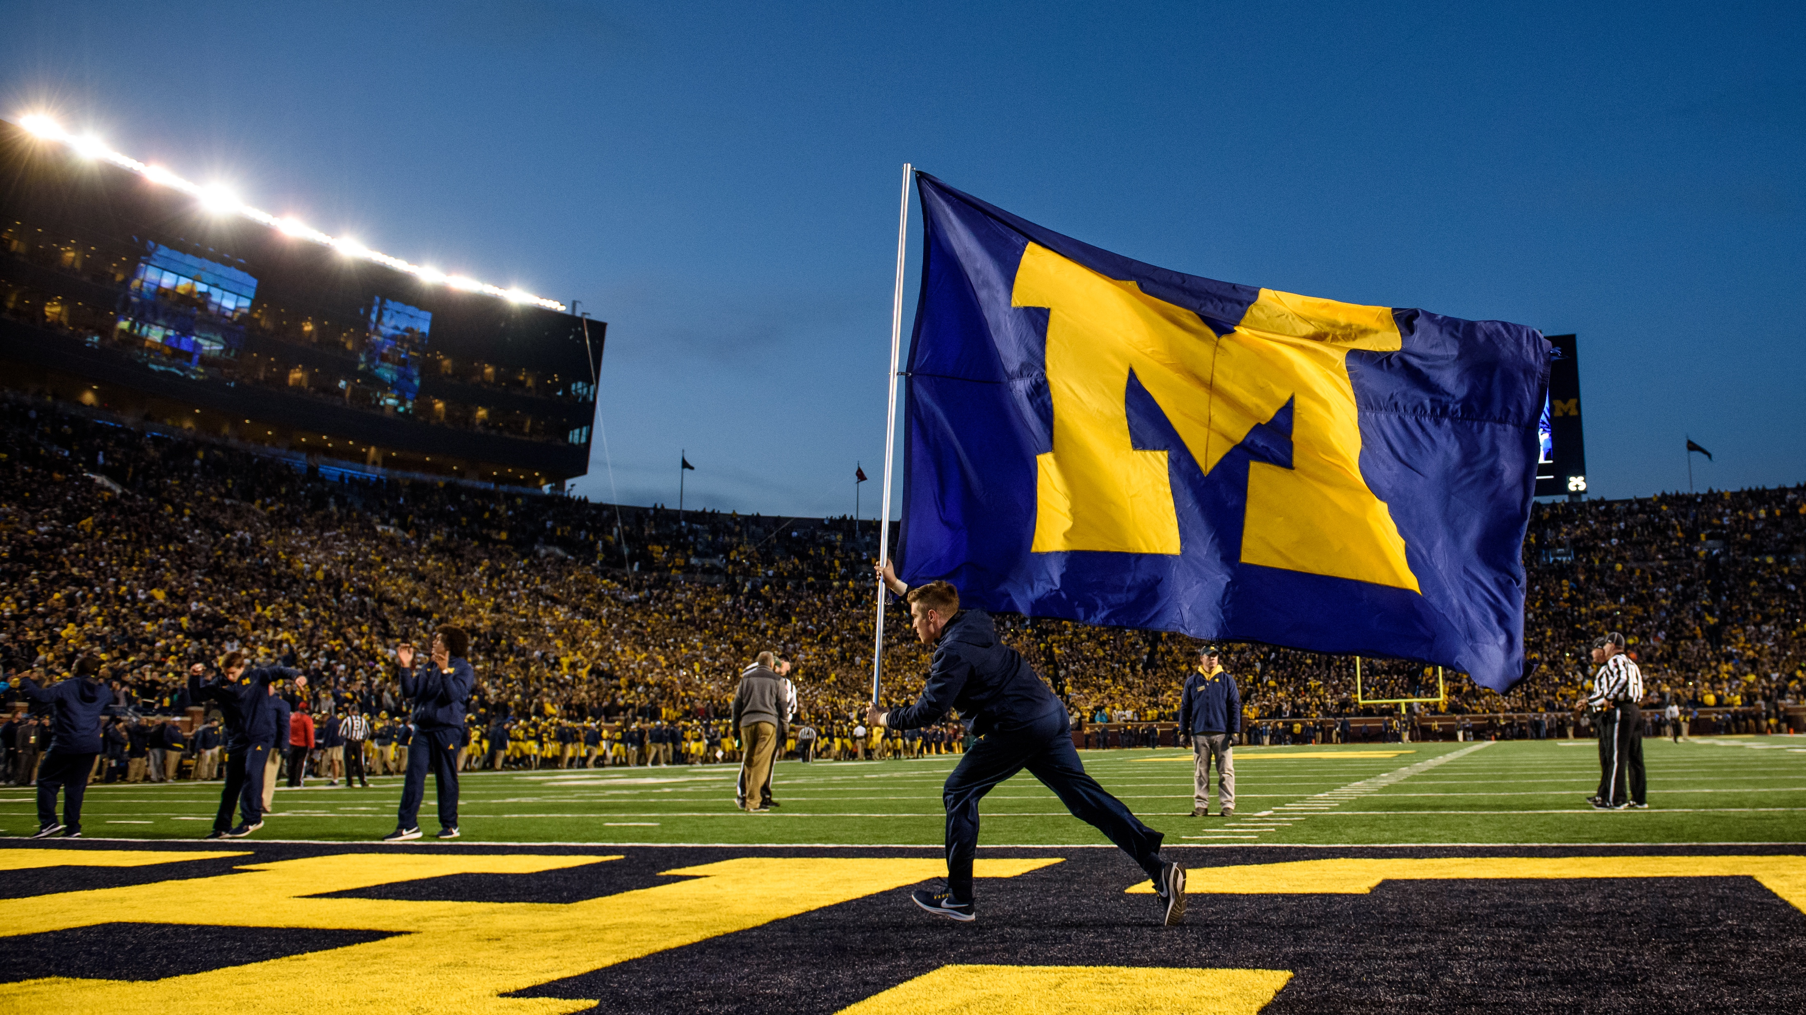
THANK YOU!
www.umsi.umich.edu
www.dr-chuck.com
www.py4e.com
www.tsugi.org

